Slide 1
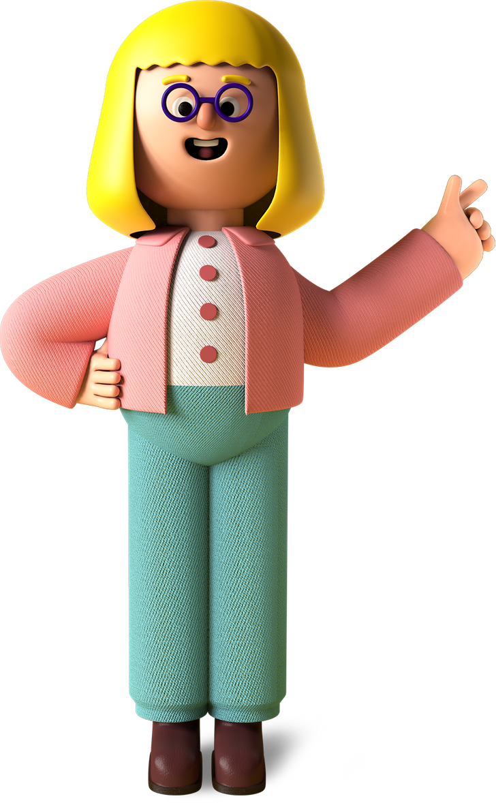
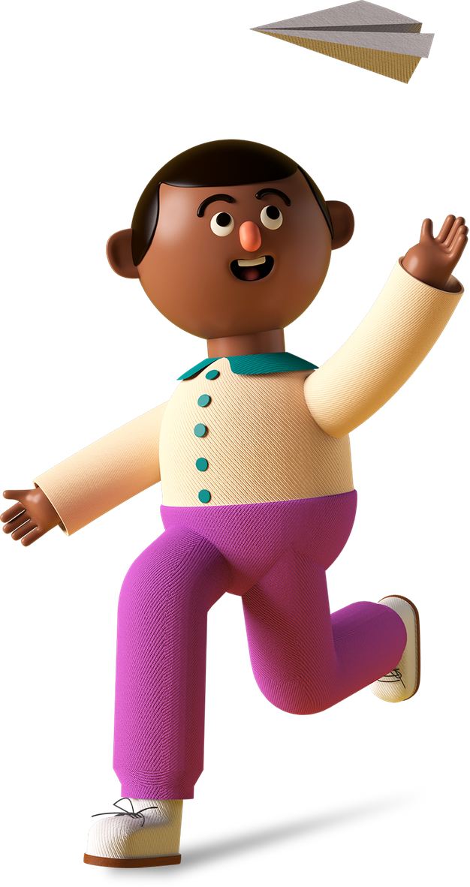

Student
Project

Slide 2

Project Name
Squariads

Slide 3
Project Link
https://studio.code.org/projects/gamelab/ZSNmy-kLe_LPJ32Drrv507YFypXl2ACTV6qJgxa0oEU

Slide 4

My favorite part about the project
How the ball bounce each other
I find the codes very interested to experiment with the ball

Slide 5

What I learned from it
01
Command and functions
02
Different type of objects I am able to create
03
Fun doing experiments with the sprite properties

Slide 6
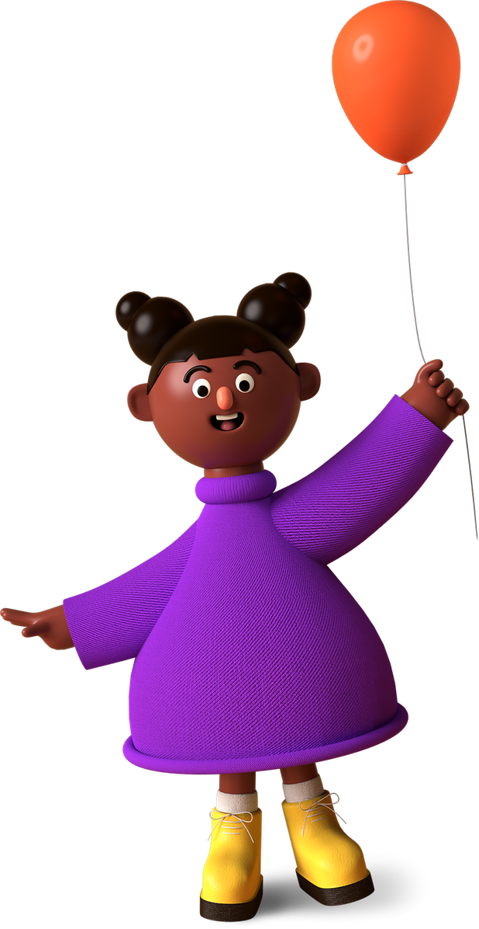
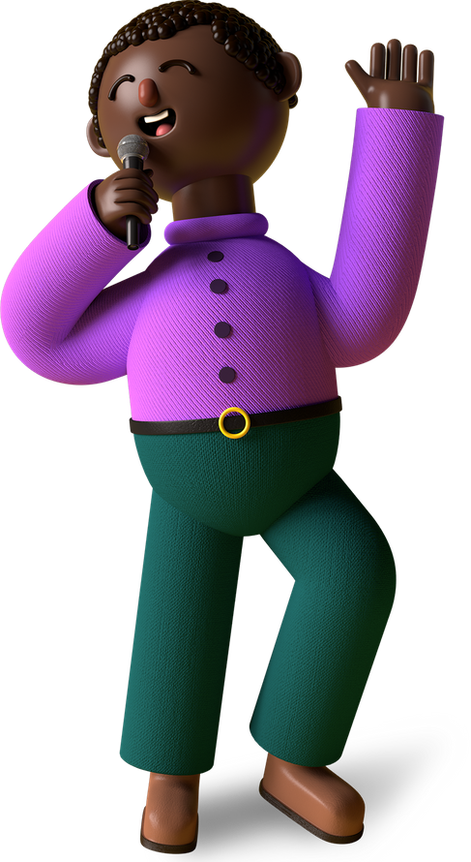
Thank You, Merry X’Mas & A Happy New Year From (Abhinav),
A Young Coder In The Making!

